Slide 1

Prevention - Moving Upstream
Annual Report of the Director of Public Health 2022

Slide 2
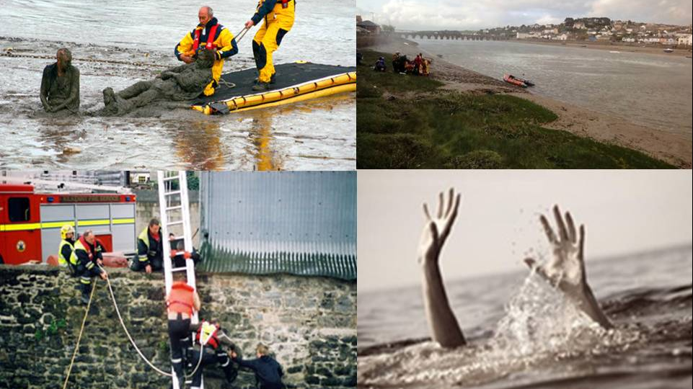

Slide 3


Slide 4
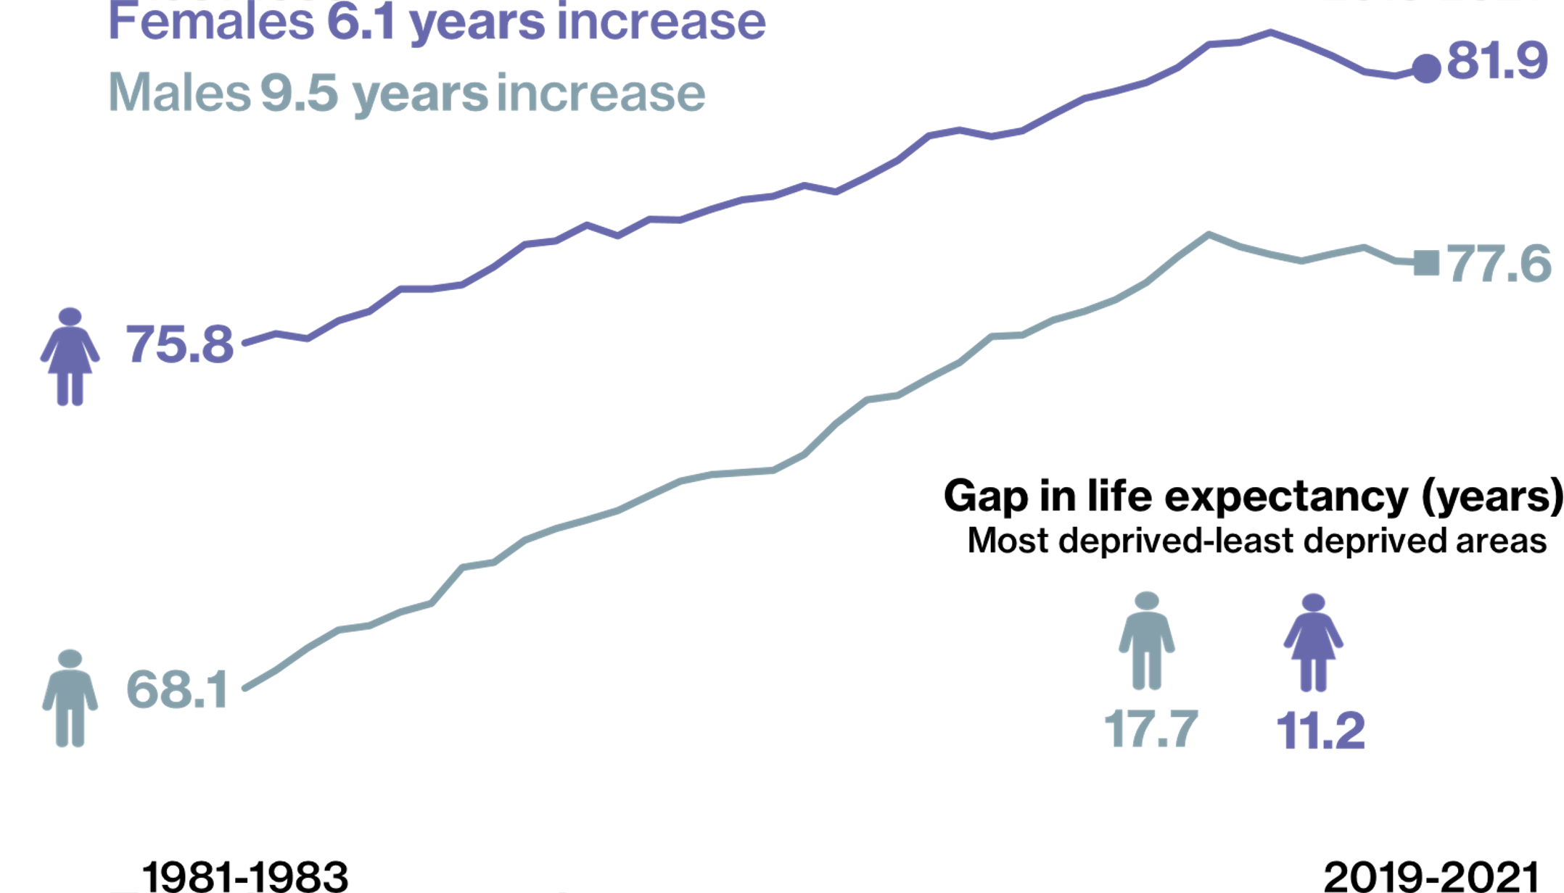
Life Expectancy Trends
Source: National Records of Scotland

Slide 5
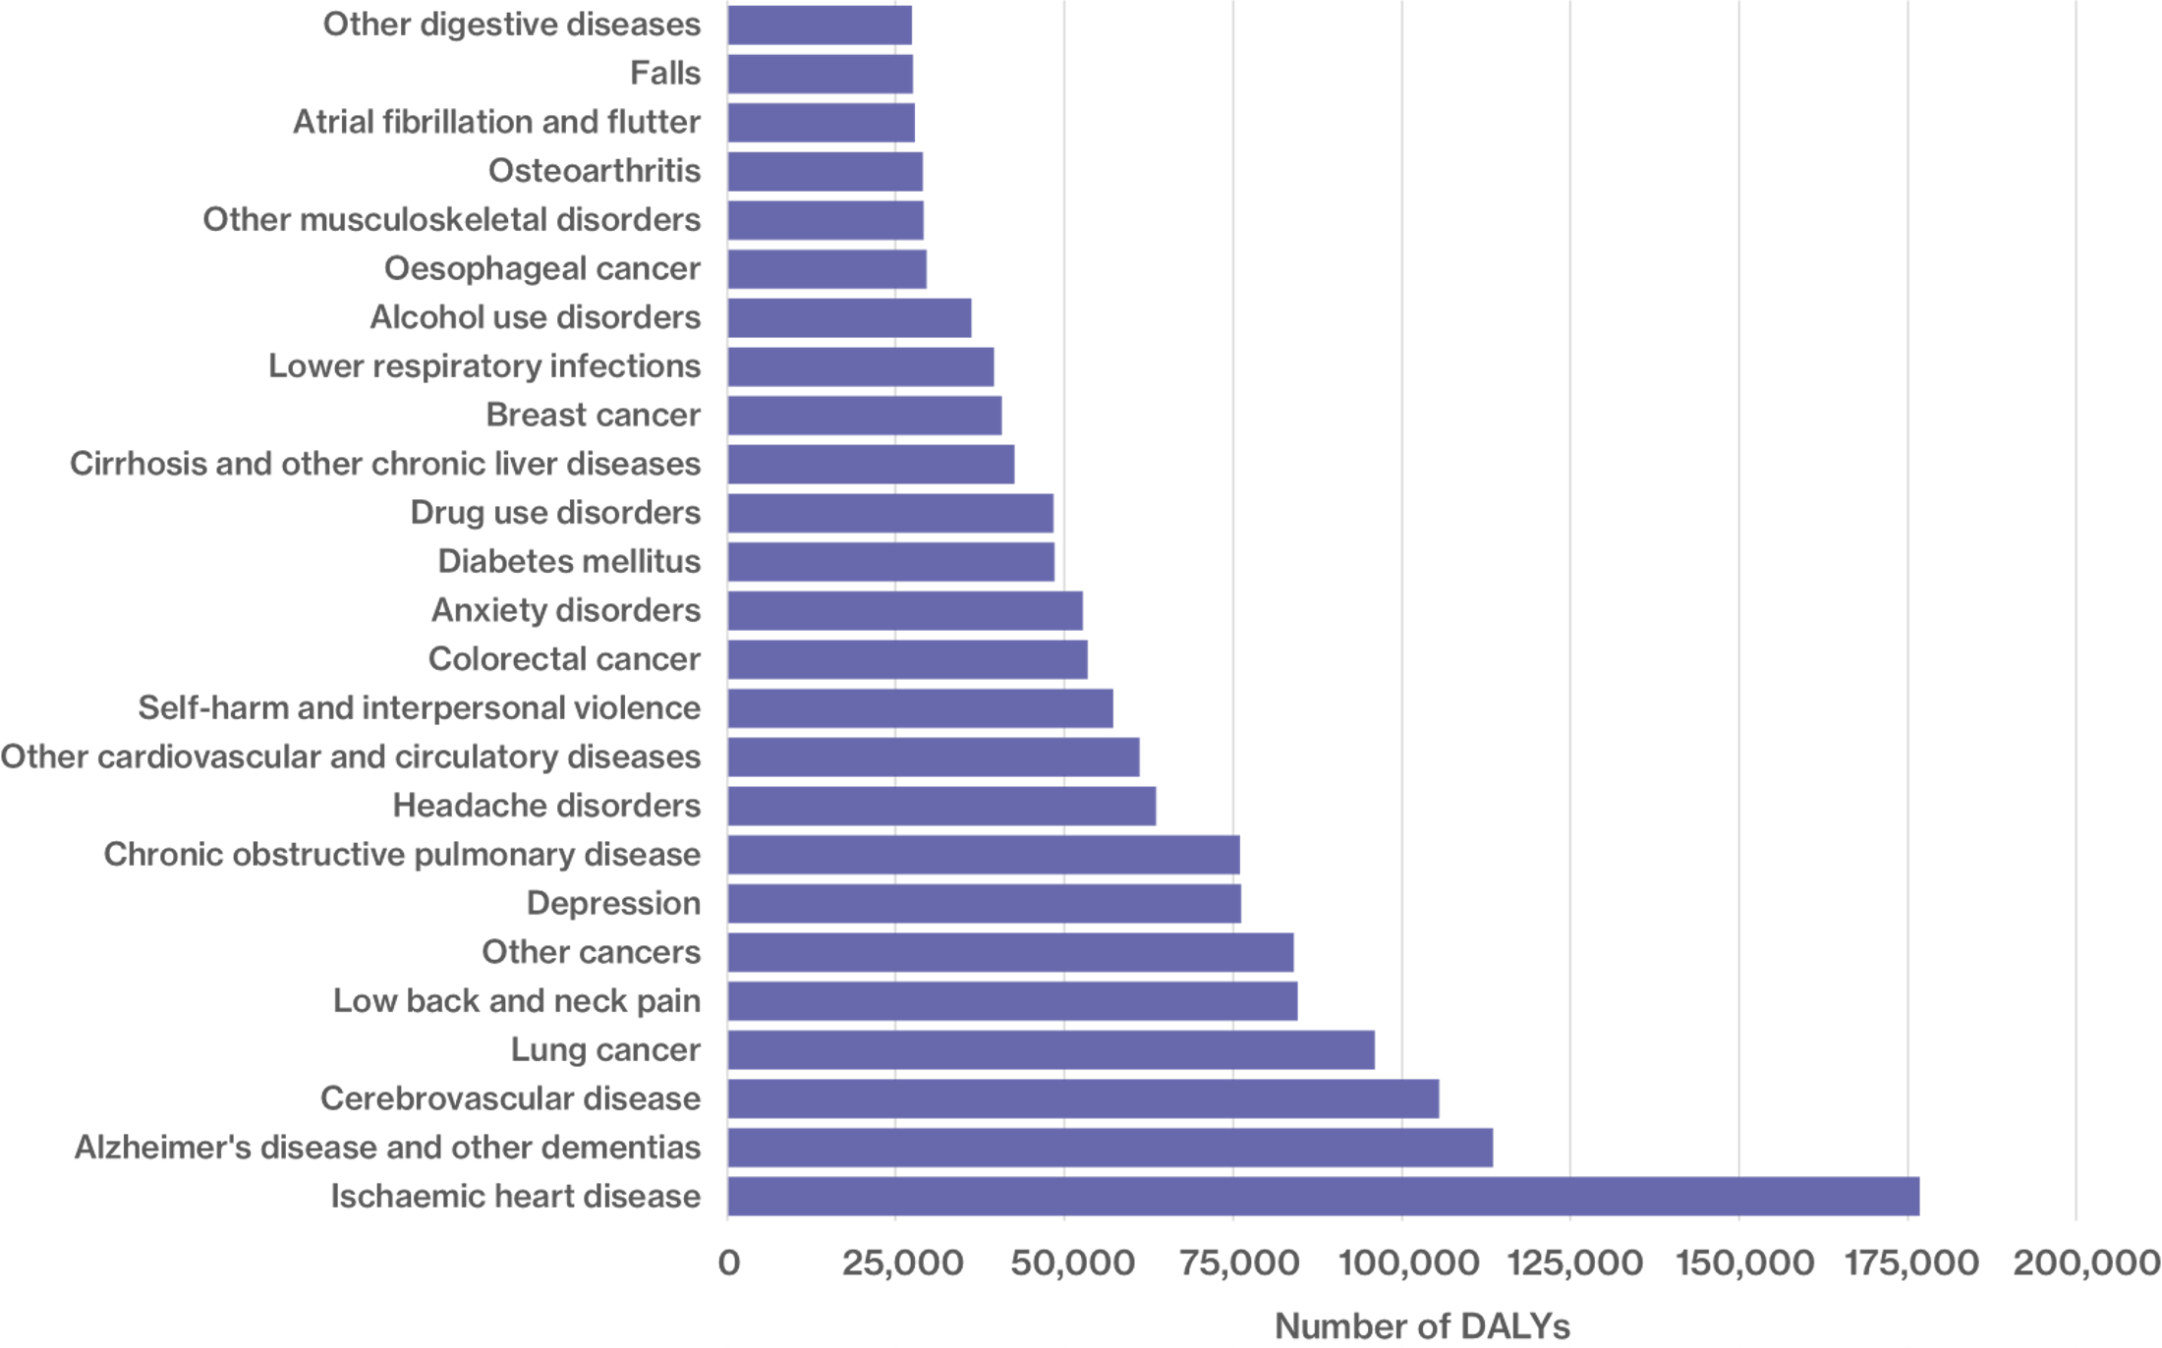
Leading Causes of Health Loss
Source: Scottish Burden of Disease Study

Slide 6
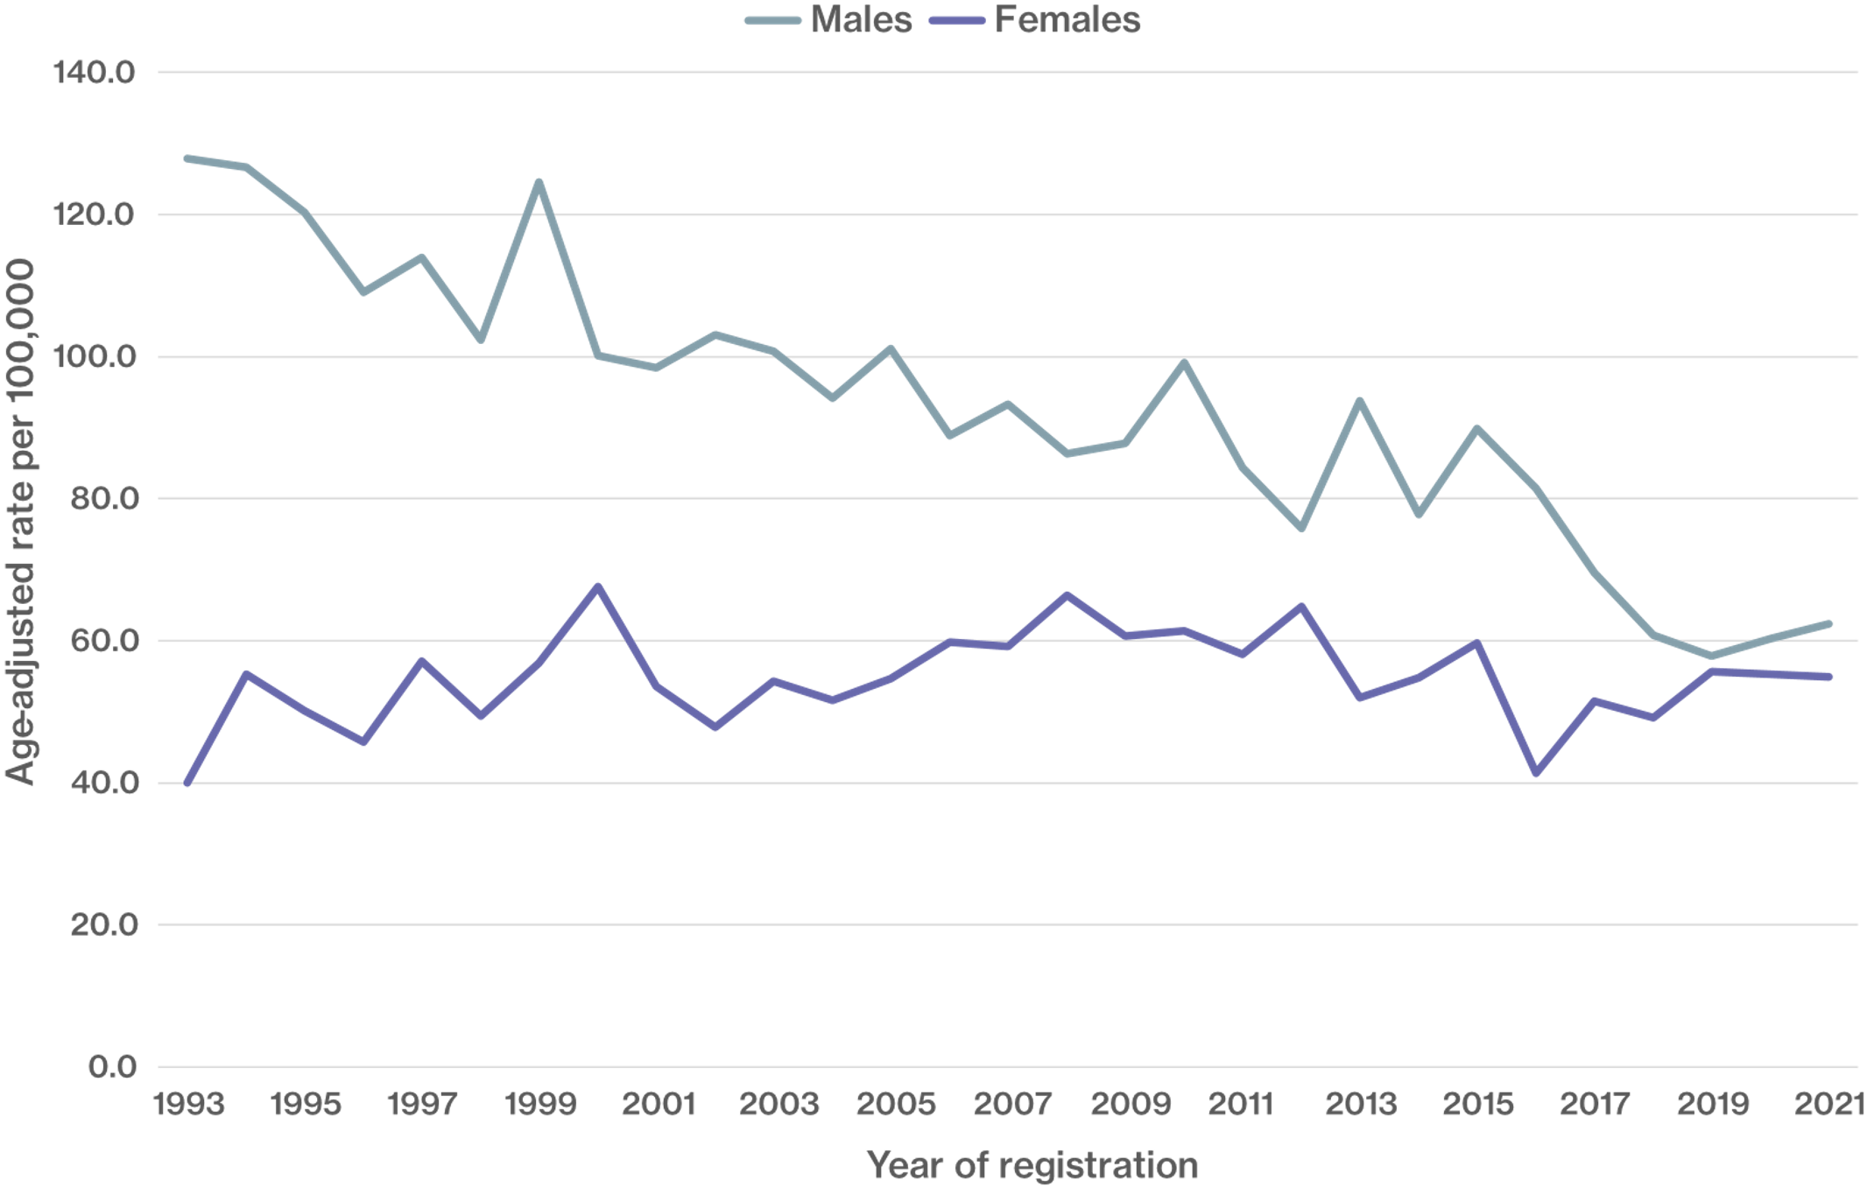
Lung Cancer Death Rates
Source: National Records of Scotland, Public Health Scotland

Slide 7
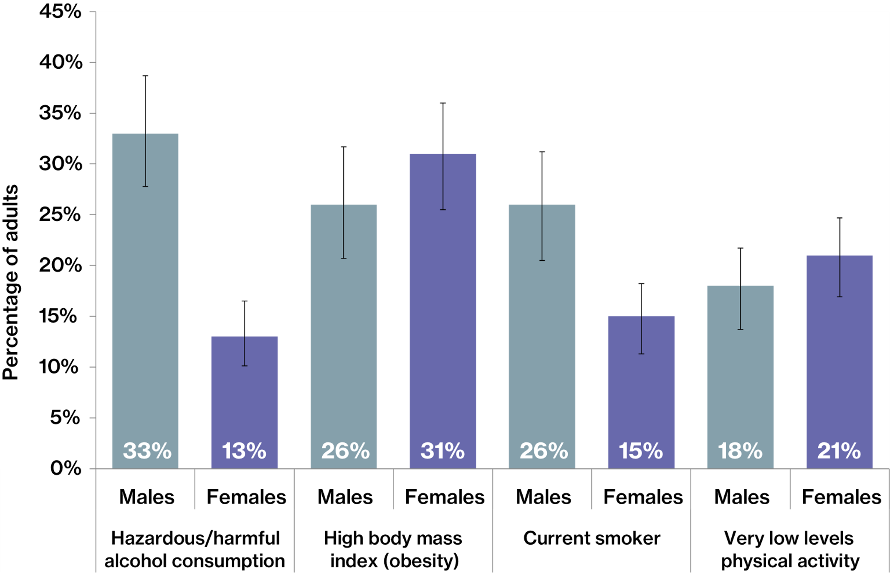
Risk Factor Prevalence 2016-2019
Source: Scottish Health Survey

Slide 8
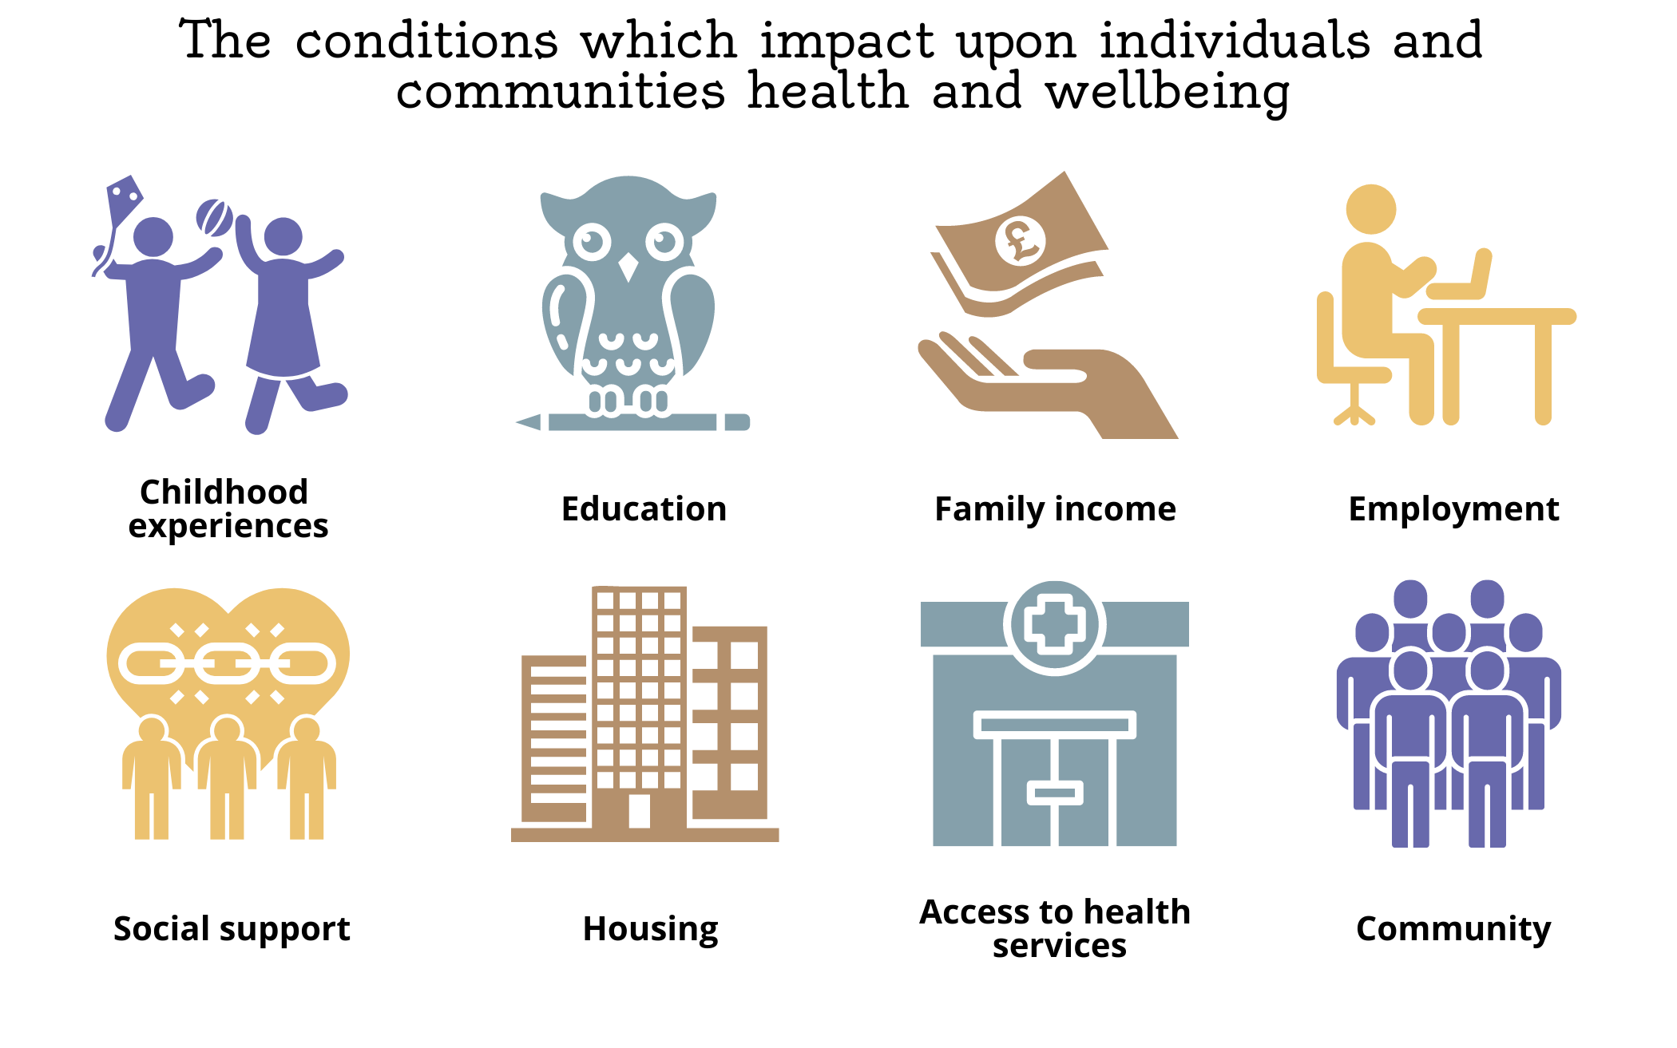
Social Determinants of Health
Source: Adapted from NHS Health Scotland

Slide 9
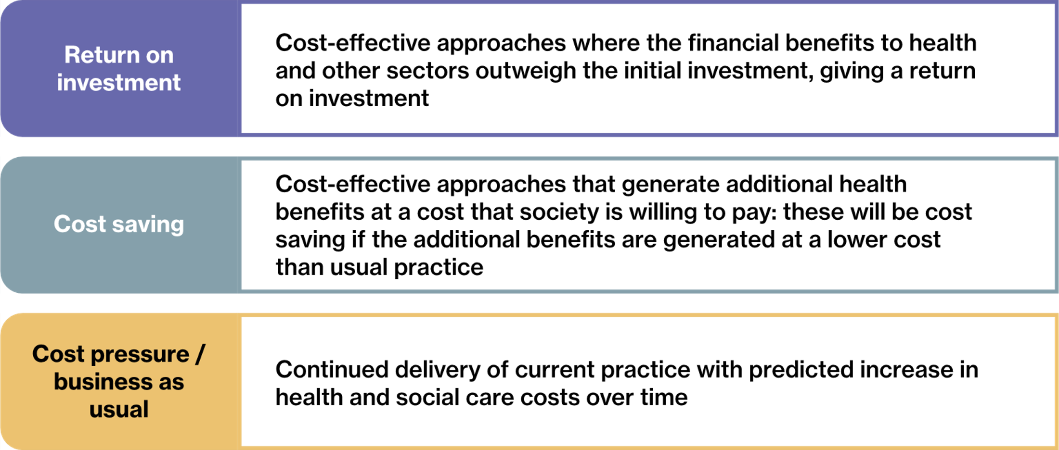
Hierarchy of Prevention
Source: Adapted from World Health Organisation

Slide 10
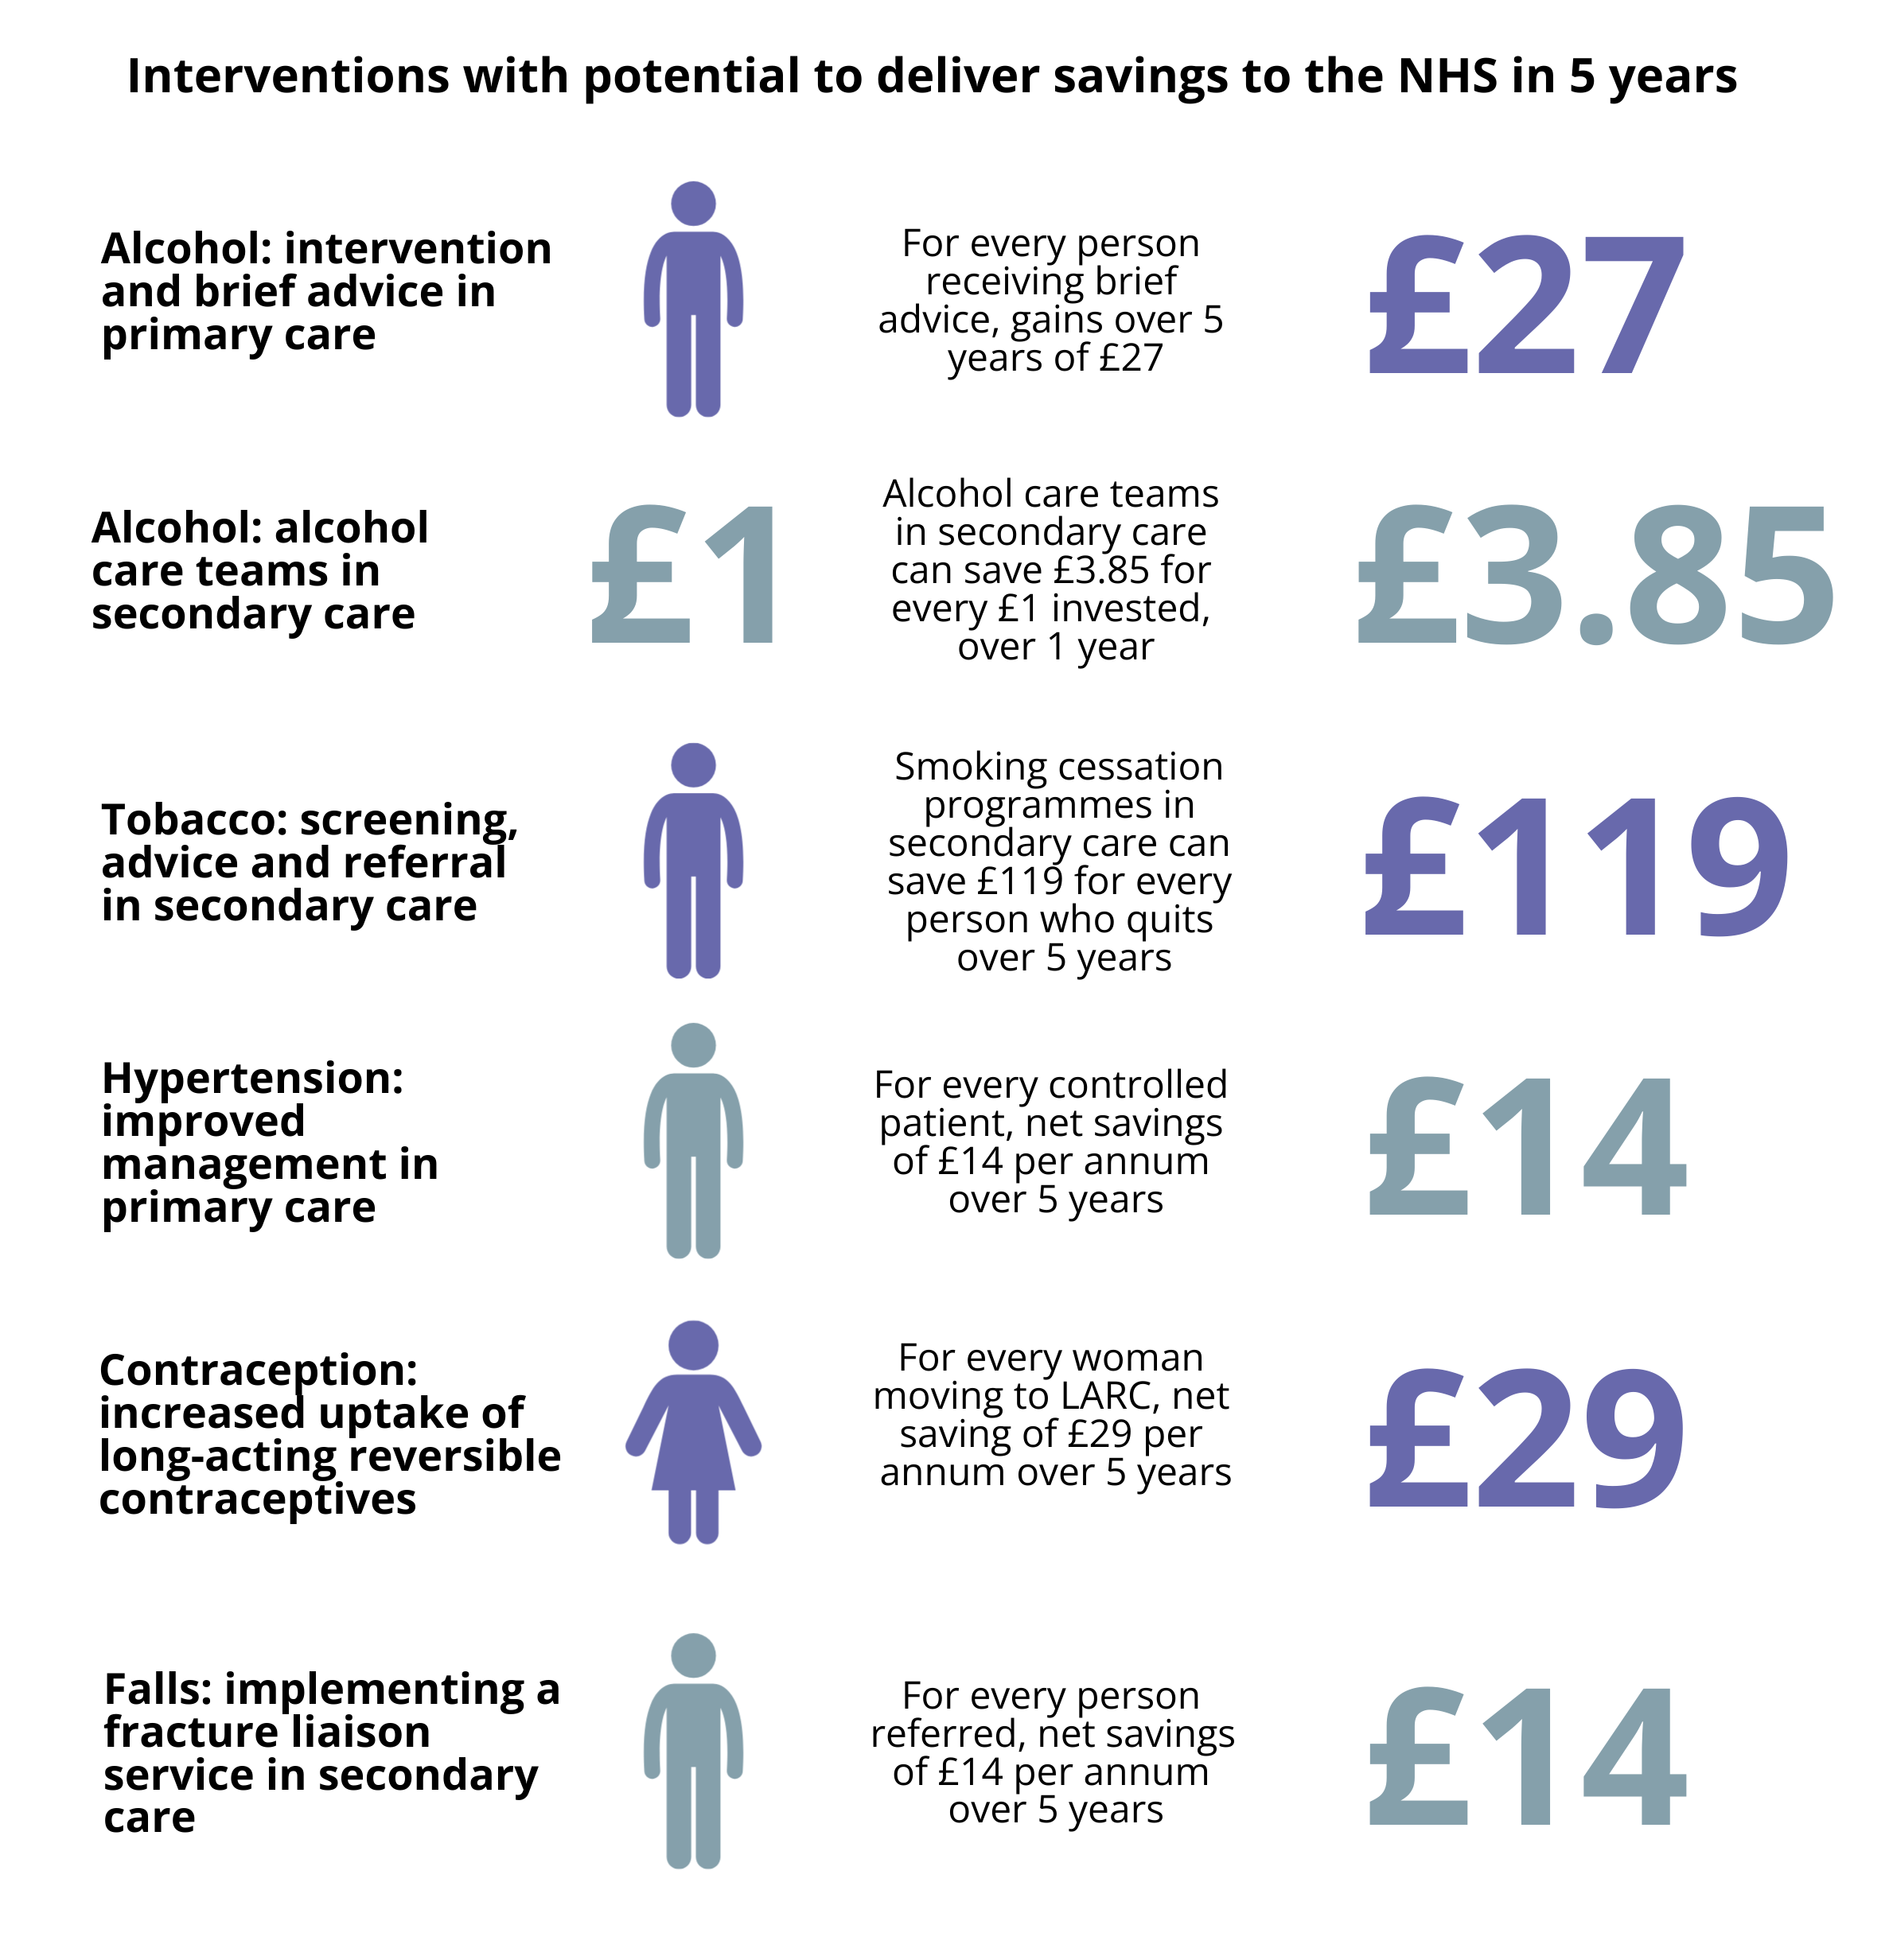
Return on Investment
Source: Adapted from Public Health England

Slide 11
Case Studies
Smokefree
Community Link Workers
Planet Youth
Infant Feeding
Money Counts
Living Well
Health Protection
Vitamin D3
Co-production

Slide 12
Selected Recommendations
Prevention must be explicitly considered as a part of all service and pathway design or redesign in health and social care.
Resources allocated to prevention should be identified within NHS Highland for comparison with treatment resources.
Preventative activity in early years should be maintained and strengthened including infant feeding and supporting parents.
Prevention programmes known to be effective must be implemented and managed to give optimum results. These include tobacco control and alcohol programmes and include specific work to reduce the burden of smoking and alcohol related disease in hospitals.

