Slide 1


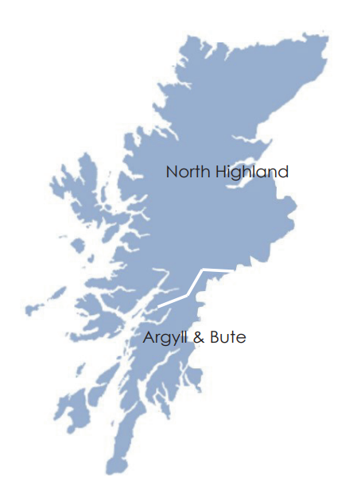

North Highland Health and Social Care Partnership
Performance and Quality Report
11 January 2023
  The North Highland Health and Social Care Partnership Performance Framework is a set of performance indicators used to monitor progress and evidence the effectiveness of the services that North Highland provides as aligned with the Annual Delivery Plan. The performance indicators should primarily be reported to the Health and Social Care Committee for scrutiny, assurance and review. A subset of these indicators will then be incorporated in the Board Integrated Performance and Quality Report.
.

Slide 2




North Highland Health & Social Care Partnership
  In order to standardise the production and interpretation a common format is being introduced for all dashboards within NHS Highland. There is a need to establish targets for improvement measures and these will be developed for incorporation into the Annual Delivery Plan for NHS Highland.
It is recommended that:
Committee consider and review the agreed Performance Framework identifying any areas requiring further information or inclusion in future reports.
Committee to note that although the continued focus is on Adult Social Care data, additional data on DHDs and Mental Health is included.

Slide 3
Development Session
In line with the NHS Highland IPQR, it is intended for this developing report to be more inclusive of the wider Partnership requirements and to further develop indicators in agreement with the Community Services Directorate, Adult Social Care SLT, and HHSCC members that will align with the new ‘Together We Care’ Strategy and the Annual Delivery Plan objectives.
A Development sessions was held with committee in September 2022 where the format of the report and ASC indicators were discussed in detail with discussion on possible indicators to be included in future reports.
Content:
Care-at-Home and Care Homes – slides, 4-6 & 7-8
Delayed Discharge – slides 9-10
Self Directed Support/Carer Short Breaks – slides 11-13
Adult Protection included – slide 14
Mental Health Psychological Therapies and Community Mental Health Services – slides 15-16
North Highland Drug & Alcohol Services – slide 17
Non MMI Non Reportable Specialties Waitlists – slides 18 & 19
National Integration and relevant Ministerial indicators – to be reported as an annual inclusion

Slide 4

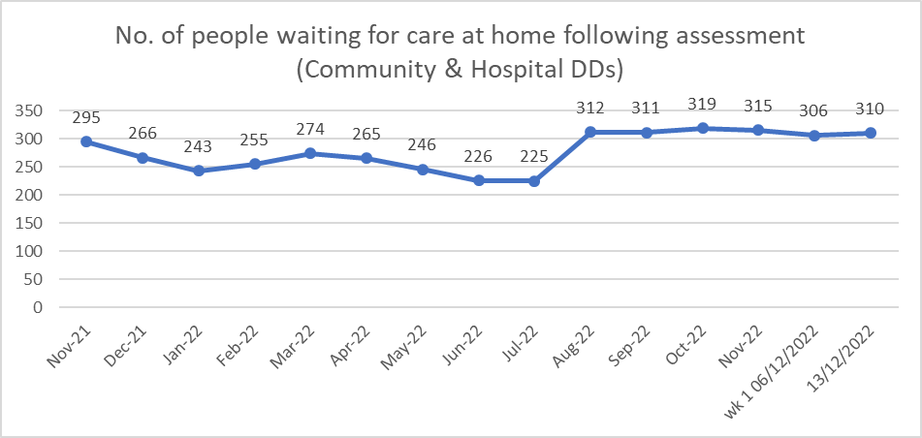
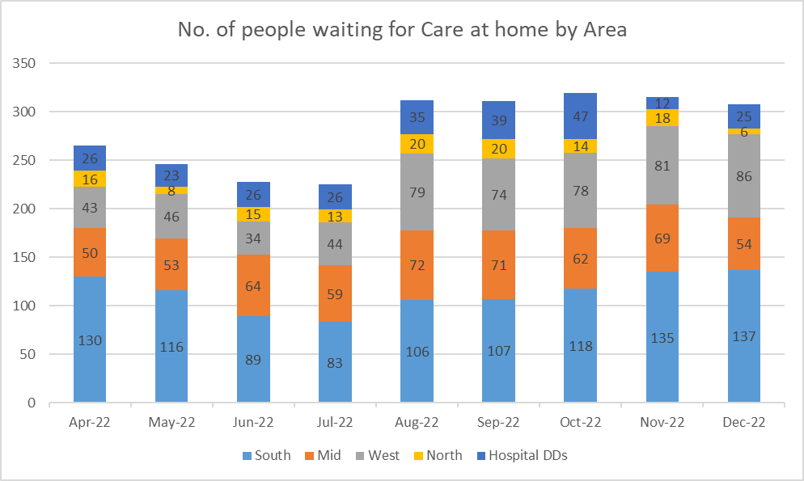
Strategic Objective 3 Outcome 9 – Care Well (Adult Social care)
Priority 2 - Embed a place approach to Home Based Care & Support and care homes so that proactive care is provided tailored to the needs of the individual
Priority 9A, 9B, 9C – Work together with H & SC partners by delivering care and support together that puts our population, families and carers experience at the heart
North Highland Care at Home
Currently provided weekly as part of the PHS weekly return. This manual data return commenced in winter 2021 and is provided by care at home (CAH) colleagues. Hospital DHD’s are added to the Community data.
This data is published by PHS and weekly returns from CAH officers are provided to allow for validation and analysis.
Graph 1 – Care at Home (Community & Hospital DHD’s) – the total number of people waiting on a care at home service to commence following completion of a social care assessment continues to challenge system flow with 310 people waiting for a CAH service.
Graph 2 – Care at Home (Area level) - the number of people waiting on a care at home service to commence following completion of a social care assessment, at an area level.
Update 20/12/2022

Slide 5
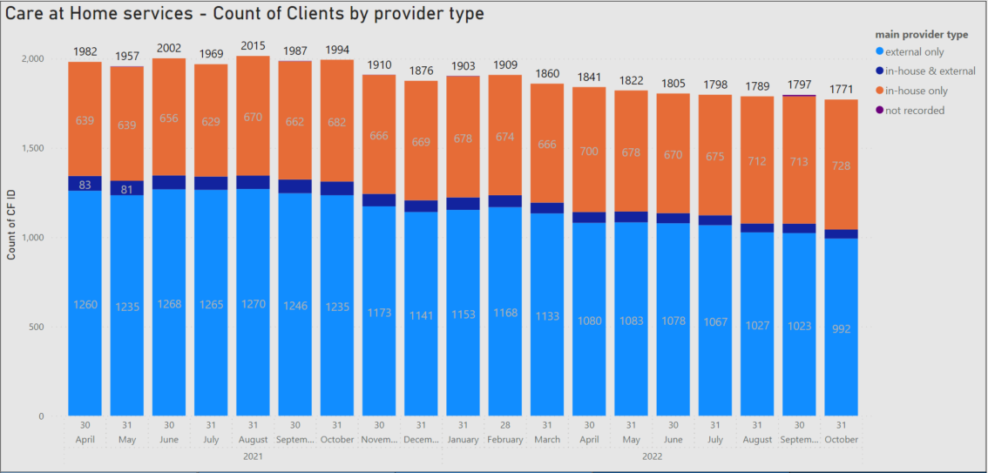
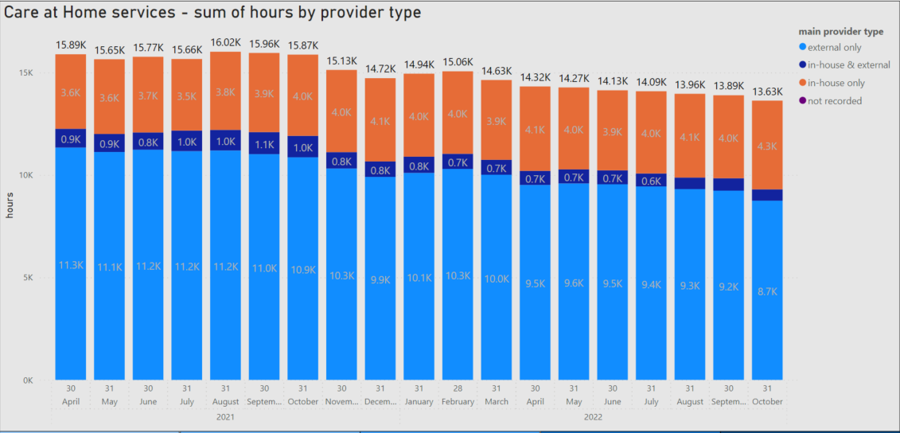
Strategic Objective 3 Outcome 9 – Care Well (Adult Social care)
Priority 2 - Embed a place approach to Home Based Care & Support and care homes so that proactive care is provided tailored to the needs of the individual
Priority 9A, 9B, 9C – Work together with H & SC partners by delivering care and support together that puts our population, families and carers experience at the heart
North Highland Care at Home
Care at Home
Significant and sustained reduction in the number of people receiving external care-at-home, specifically due to workers leaving employment in care at home.
Growth within our in house service as NHS Highland steps in where providers are unable to deliver care at home.
There are frequent discussions with the sector to try to sustain these services and to stabilise the reduction in the workforce, to work collaboratively preparing for winter, and where possible, to release any available capacity.
Current strategic steps/work stream activity include:
Now: Responsive capacity release, collaborative recruitment and localised recruitment events.
Next:
Strategy and ambition
Workforce creation and development
Contract and commissioning redesign
NHS Highland and external care providers continue to operate in a pressured environment working in collaboration with ongoing sustained staffing and competing recruitment pressures.
Update 20/12/2022

Slide 6
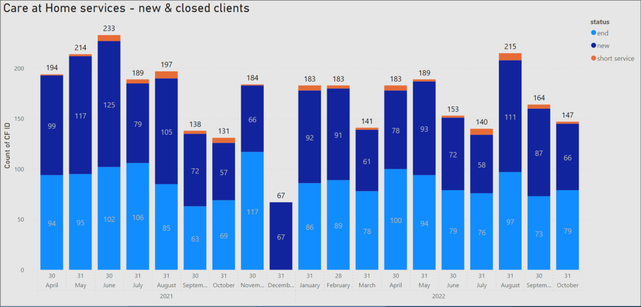
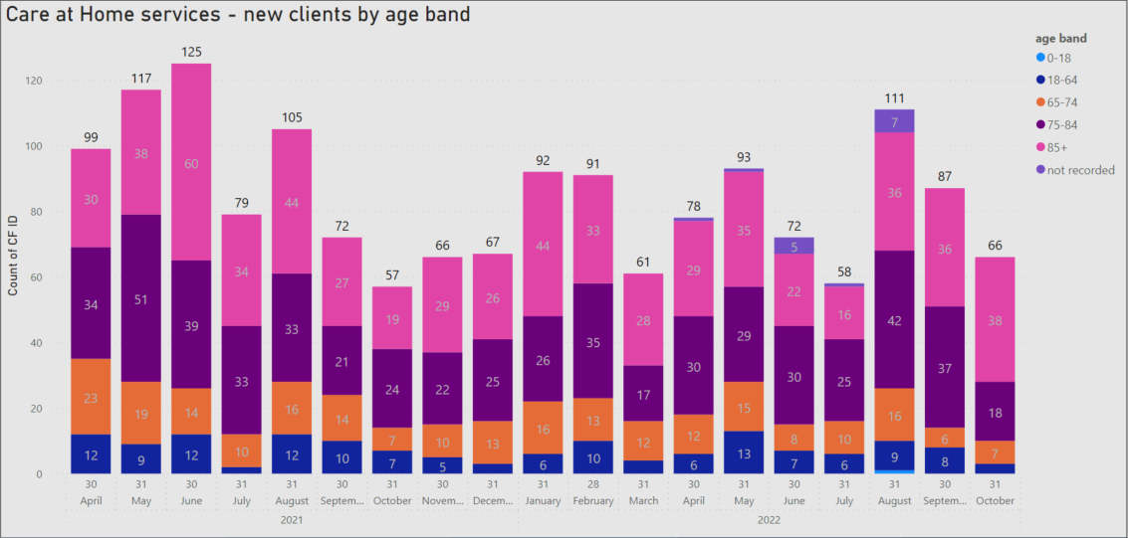
Strategic Objective 3 Outcome 9 – Care Well (Adult Social care)
Priority 2 - Embed a place approach to Home Based Care & Support and care homes so that proactive care is provided tailored to the needs of the individual
Priority 9A, 9B, 9C – Work together with H & SC partners by delivering care and support together that puts our population, families and carers experience at the heart
North Highland Care at Home
Care at Home – New & Closed Packages
Graph 1 – Shows the number of new clients and closed packages per month.
For the last reported period from July to October 22, please note that available capacity to provide care-at-home to new service users is particularly challenging due to similar staffing related pressures in both in house and commissioned services.
Graph 2 – Shows the number of new care at home service users split by age band over the same period.
Update 20/12/2022

Slide 7
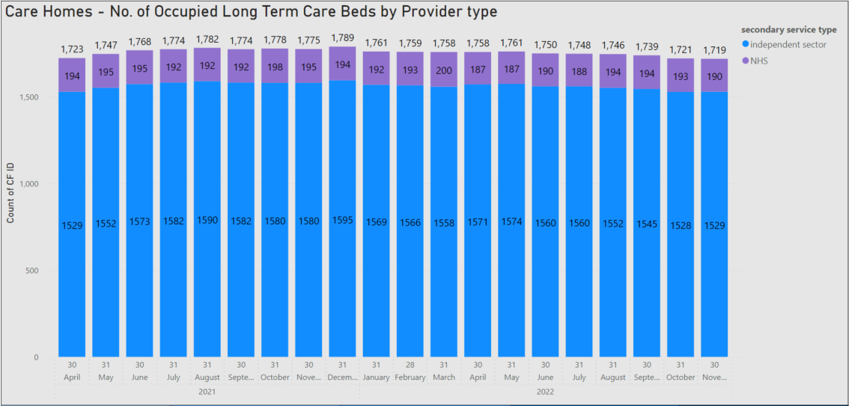
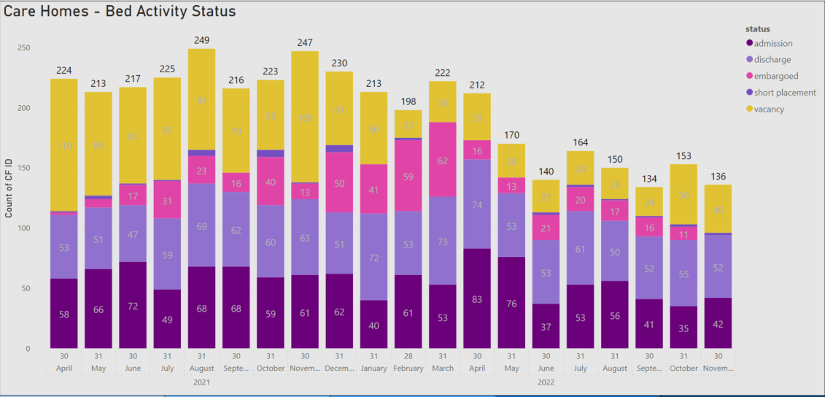
Strategic Objective 3 Outcome 9 – Care Well (Adult Social care)
Priority 2 - Embed a place approach to Home Based Care & Support and care homes so that proactive care is provided tailored to the needs of the individual
Priority 9A, 9B, 9C – Work together with H & SC partners by delivering care and support together that puts our population, families and carers experience at the heart
North Highland Care Homes
North Highland Care Homes
The care home and indeed the care at home sectors are both under significant stress and pressure. This is multi-factorial including recruitment and retention challenges, financial concerns and the remote and rural context that the services work within.
The HSCP are working closely with care home providers as the overall number of available beds continues to challenge NHS Highland with a number of providers leaving the sector and others expressing concerns about the future. The total number of externally purchased beds during Nov 22 is 1529 which is identical to the reported position at Apr 21, this is despite a number of care home closures.
During 2022-23, 3 care homes have closed, these were Shoremill, Cromarty; Budhmor House, Skye; Grandview, Grantown on Spey.
In April 2021, Eilean Dubh was registered as a new care home.
This unprecedented number of closures (usually one per annum) highlights the real challenge of supporting the care sector as various cost of living impacts, such as additional food costs, insurance, and increasing energy costs cause additional financial stress for care providers.
The HSCP are working with the Highland Council to develop a strategy for care homes and an implementation plan to span the short to longer term care environment. A development session with Highland Council and NHS officers and elected members took place on 21/11/22.
Update 20/12/2022

Slide 8
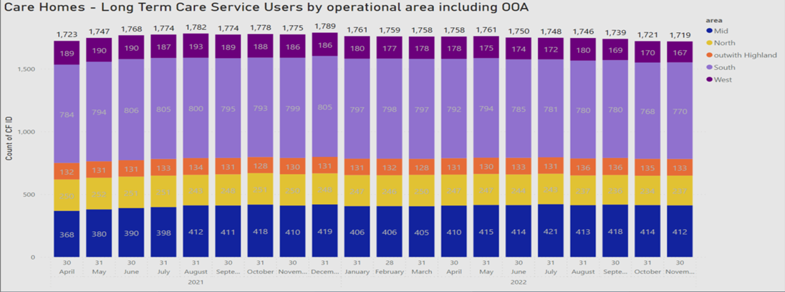
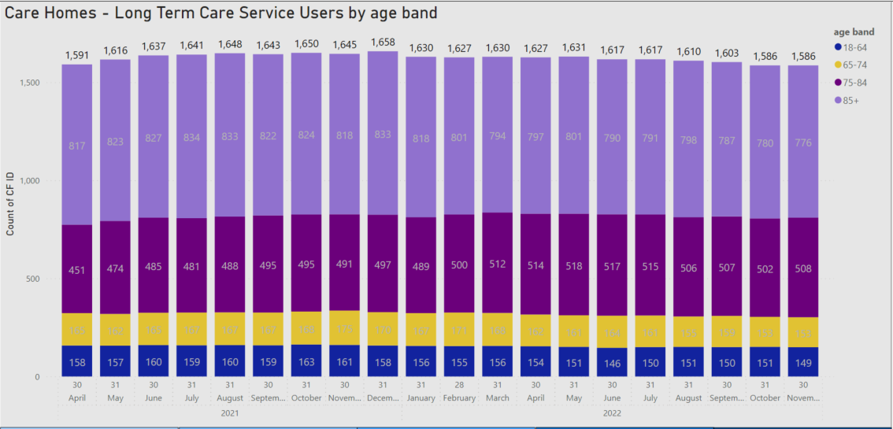
Strategic Objective 3 Outcome 9 – Care Well (Adult Social care)
Priority 2 - Embed a place approach to Home Based Care & Support and care homes so that proactive care is provided tailored to the needs of the individual
Priority 9A, 9B, 9C – Work together with H & SC partners by delivering care and support together that puts our population, families and carers experience at the heart
North Highland Care Homes
North Highland Care Homes
These graphs provide an overview of the occupied long term care beds for both external and NHS managed care homes by providing a breakdown by Area in North Highland (NH) and those placed out of area, but funded by NH.
South: 770 occupied care beds
Mid: 412 occupied care beds
North: 237 occupied care beds
West: 167 occupied care beds
Out of Area: 133 commissioned care beds
In addition a further breakdown is provided by the current age of those service users for North Highland only, showing 46% are currently over the age of 85 in both residential and nursing care settings.
Update as at 20/12/2022

Slide 9

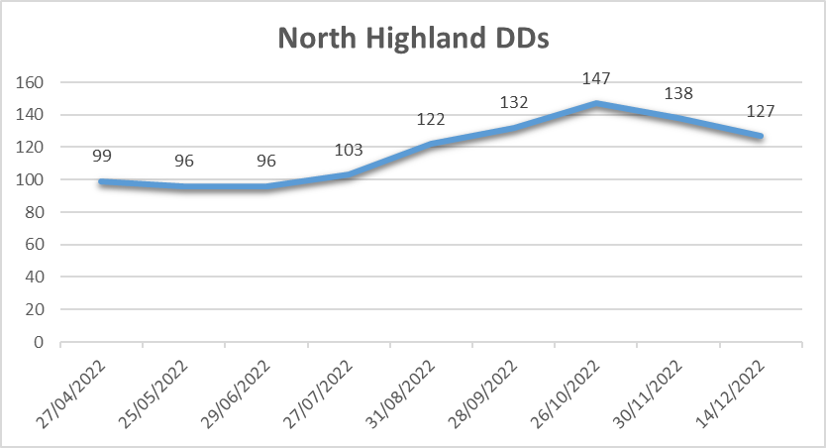
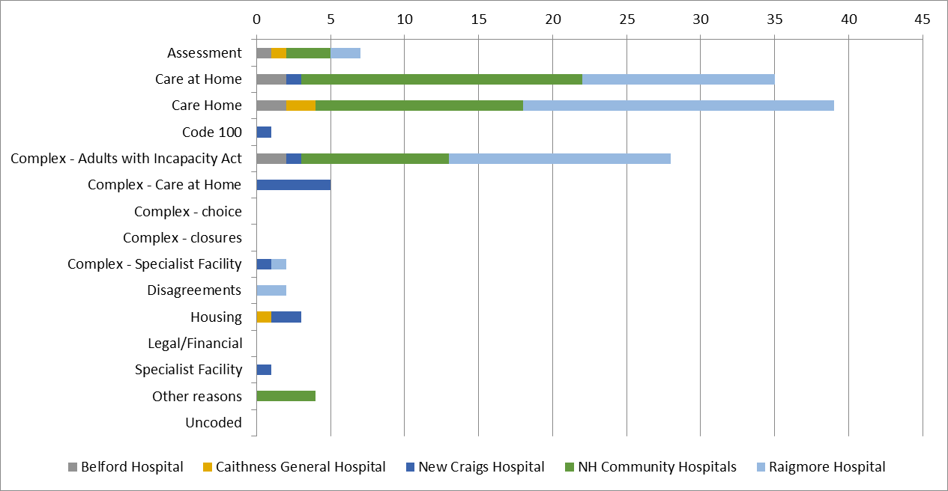
Strategic Objective 3 Outcome 11 – Respond Well
Priority 3 - Work to minimise the length of time that hospital based care is required. We will work with you, your family, and carers to adopt a “home is best” approach
Priority 11C – Ensure that our services are responsive to our population’s needs by adopting a “home is best” approach
North Highland DDs
Performance Overview​ North Highland
There is no national target for delayed discharges but we aim to ensure we get our population care for in the right place at the right time. 127 delayed discharges @ 14/12/2022 with 15 of those are code 9 (complex). Delayed discharges have been reducing since last reported in October.
The graphs show the trend for total delayed discharges for North Highland and the reason for those awaiting discharge shown at a hospital level.
Delayed discharges remain a concern both nationally and within NHS Highland. They are part of a bigger picture of a system under strain as well as the need to ensure we are focusing on reshaping how we work together.​
​There is a close relationship between the unscheduled care work required across the system and the level of delayed discharges alongside the competing challenges within acute and community services. There is a need for quality improvement work across a number of areas. This work is in progress with a number of key developments underway. This is though in the context of significant system pressure such as in adult social care and the need to effectively manage change across the organisation. ​
​Cross system working is key to ensuring success of this work as long as benchmarking from other areas to achieve sustainable improvements.​
Update 20/12/2022

Slide 10
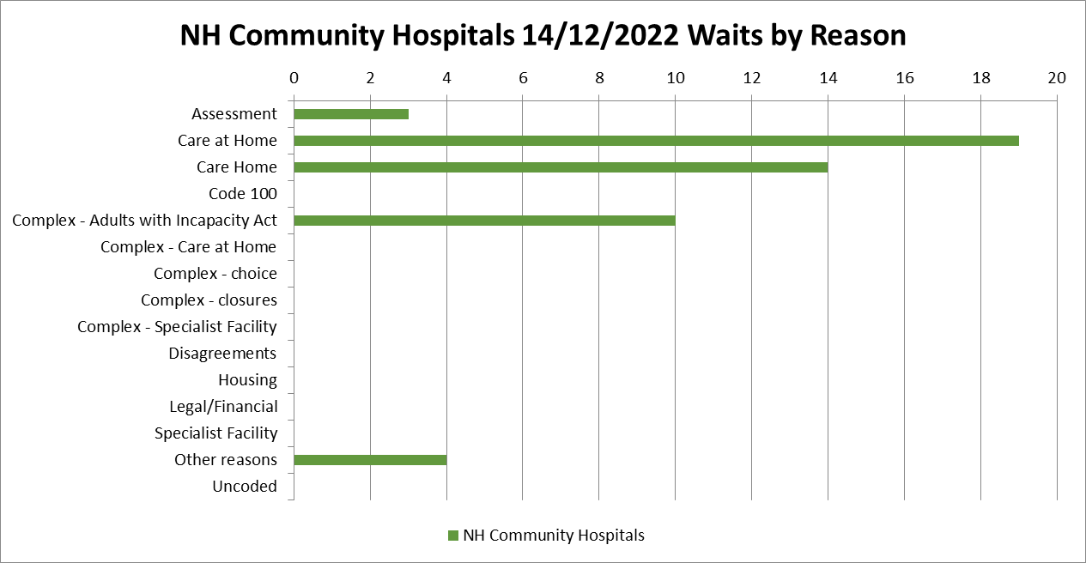
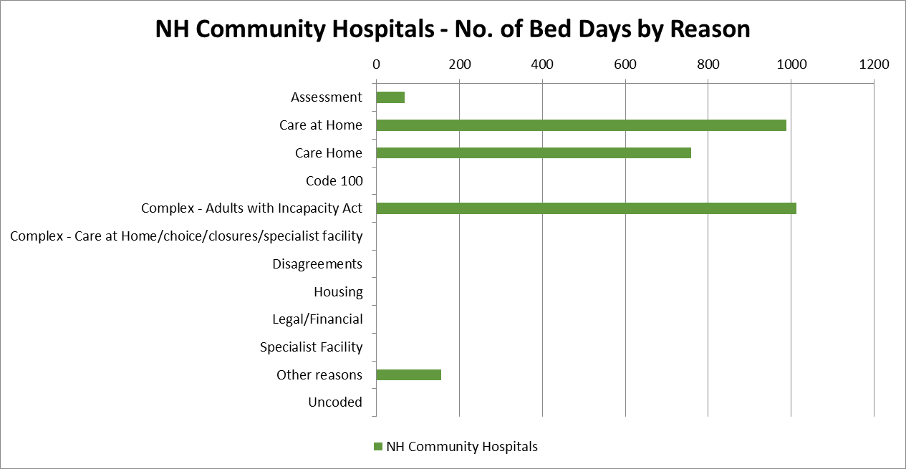
Strategic Objective 3 Outcome 11 – Respond Well & Care Well (Delayed Discharges)
Priority 3 - Work to minimise the length of time that hospital based care is required. We will work with you, your family, and carers to adopt a “home is best” approach
Priority 11C – Ensure that our services are responsive to our population’s needs by adopting a “home is best” approach.
North Highland Community Hospitals DDs
Performance Overview​ North Highland
There is no national target for delayed discharges but we aim to ensure we get our population care for in the right place at the right time.
Of the 127 delayed discharges at 14/12/2022, 50 are in North Highland Community Hospitals. 12 are in New Craigs hospital and all other delayed discharges are in acute hospitals. This is a reducing position on the October position previously reported (145).
Update 20/12/2022

Slide 11
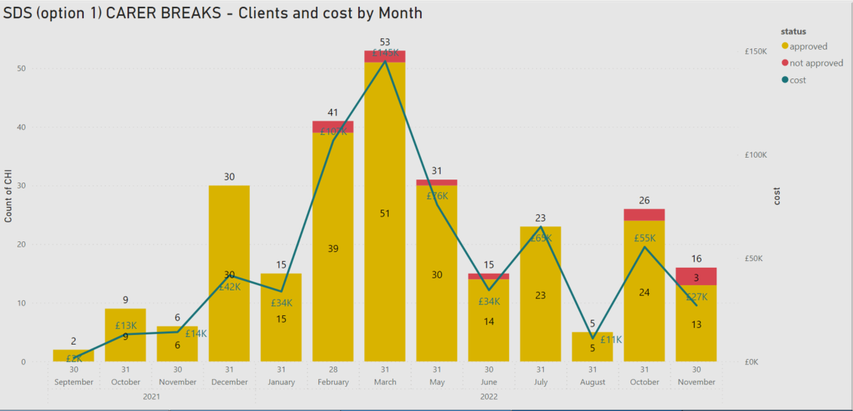
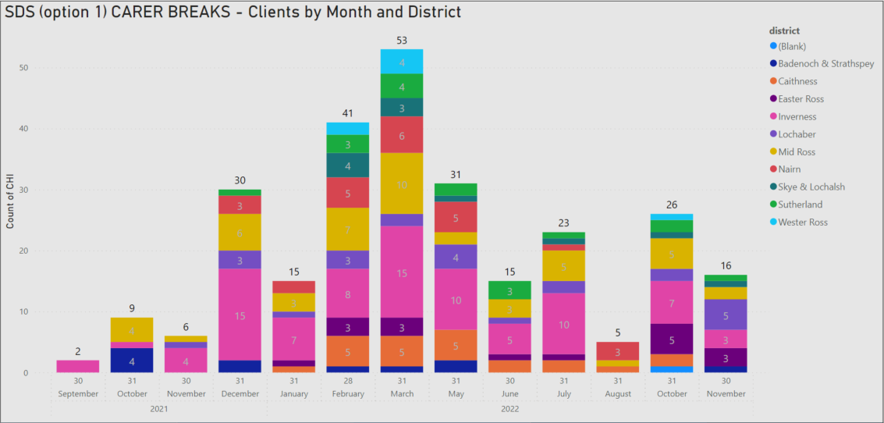
Strategic Objective 3 Outcome 9 – Care Well (Adult Social care)
Priority 2 - Embed a place approach to Home Based Care & Support and care homes so that proactive care is provided tailored to the needs of the individual
Priority 9A, 9B, 9C – Work together with H & SC partners by delivering care and support together that puts our population, families and carers experience at the heart
Carer Breaks – Option 1 (DP)
SDS Option 1 Carer Breaks
As reported to previous committee and included in previous Carer Programme update reports, this scheme to support unpaid carers started in September 2021 and is an integral component of a balanced “carers programme” aimed at meeting our duties under the Carers Act.
The peak of this scheme was during February to April 2022 with at the end of November, some 261 individuals benefitting.
It is the aim of NHS Highland to ensure that unpaid carers continue to access a range of services and we are committed to supporting carers, while maintaining our Option 1 short breaks scheme to increase the access of carers to flexible, personalised ways to provide them with a break.
It is well evaluated and continues to be well received by carers and their families.
Update 20/12/2022

Slide 12
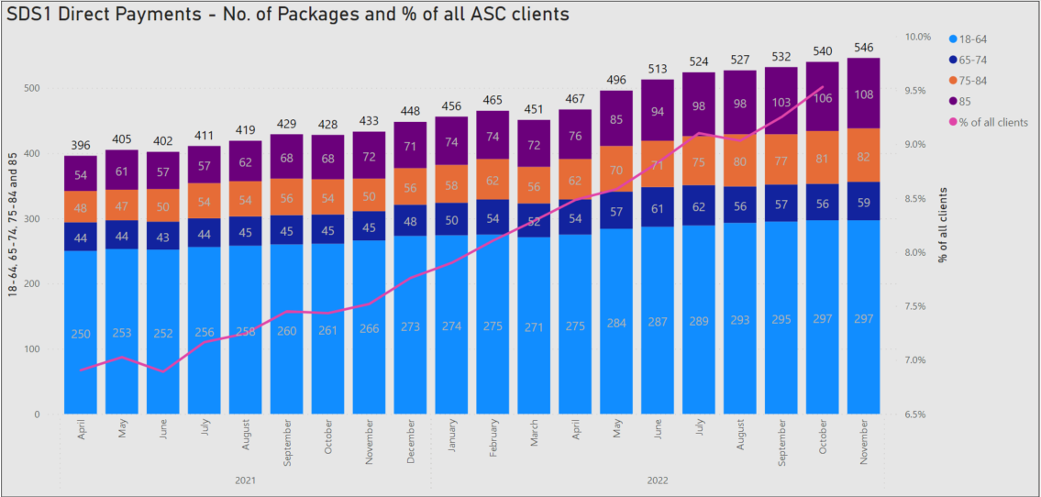
Strategic Objective 3 Outcome 9 – Care Well (Adult Social care)
Priority 2 - Embed a place approach to Home Based Care & Support and care homes so that proactive care is provided tailored to the needs of the individual
Priority 9A, 9B, 9C – Work together with H & SC partners by delivering care and support together that puts our population, families and carers experience at the heart
Self Directed Support – Option1 (DP)
SDS Option 1 (Direct Payments)
Sustained growth in Option 1s with increases for both younger and older adults in some of our more remote and rural areas.
The increase does highlight the unavailability of care options and a real market shift as we are unable to commission “traditionally delivered services” through a commissioned provider or by NHS Highland.
During recent months, we are aware of some Option 1 recipients struggling to recruit staff and personal assistants which clearly demonstrates the resource pressure affecting all areas of care delivery.
Our current number of active service users receiving a direct payment is 546 with a projected annual cost of £9.9m.
As an integral component of our Self Directed Support Strategy, development work continues with the SDS Peer Support Group, a group representing users of these services, and Community Contacts to design a co-produced proposal with NHS Highland which will identify and include the core cost components and move closer to identifying the “true cost” of delivering care for Options 1s.
Currently Option 1 service users are paid based on an initial rate of £15.01 per hour which is significantly less than external rates paid to providers.
Update 20/12/22

Slide 13
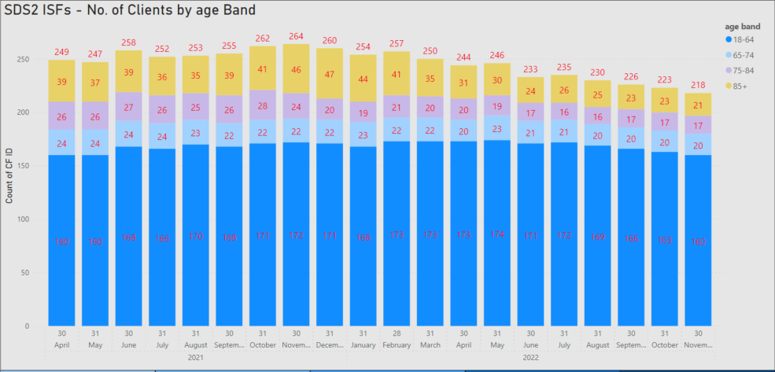
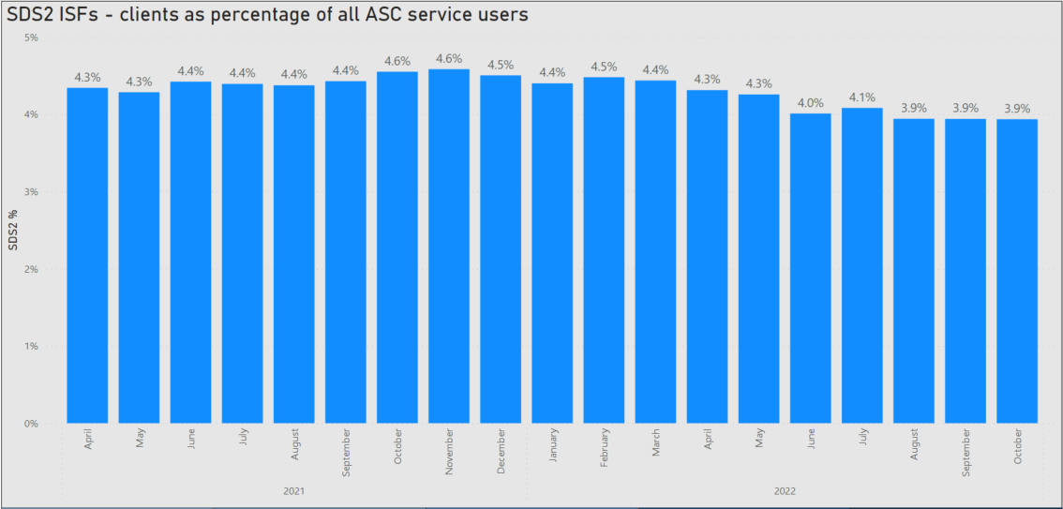
Strategic Objective 3 Outcome 9 – Care Well (Adult Social care)
Priority 2 - Embed a place approach to Home Based Care & Support and care homes so that proactive care is provided tailored to the needs of the individual
Priority 9A, 9B, 9C – Work together with H & SC partners by delivering care and support together that puts our population, families and carers experience at the heart
Self Directed Support – Option2 (ISF)
SDS Option 2 (Individual Service Funds)
Recent sustained reduction from June 2022 in the overall number of ISFs split by age band, highlighting resource pressures which is a recurring theme across Health and Social Care.
Our current number of active service users receiving an ISF is 218 as at November 2022 with a projected annual cost of £4.6m.
As part of our Self Directed Support Strategy, work will continue in partnership with In Control Scotland as a participating site (there are 6 other partner agency sites across Scotland) to work together to better understand and resolve any process barriers to growing ISFs.
3 successful workshops were held during September and November 2022 with a number of actions agreed and progressing across NHS Highland in partnership with other stakeholders.
Update 20/12/22

Slide 14
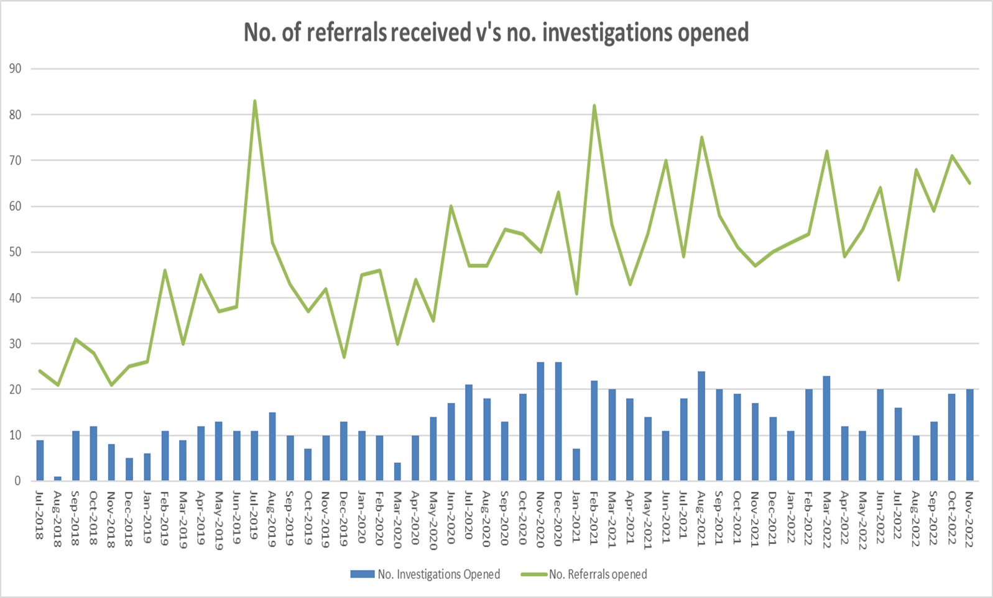
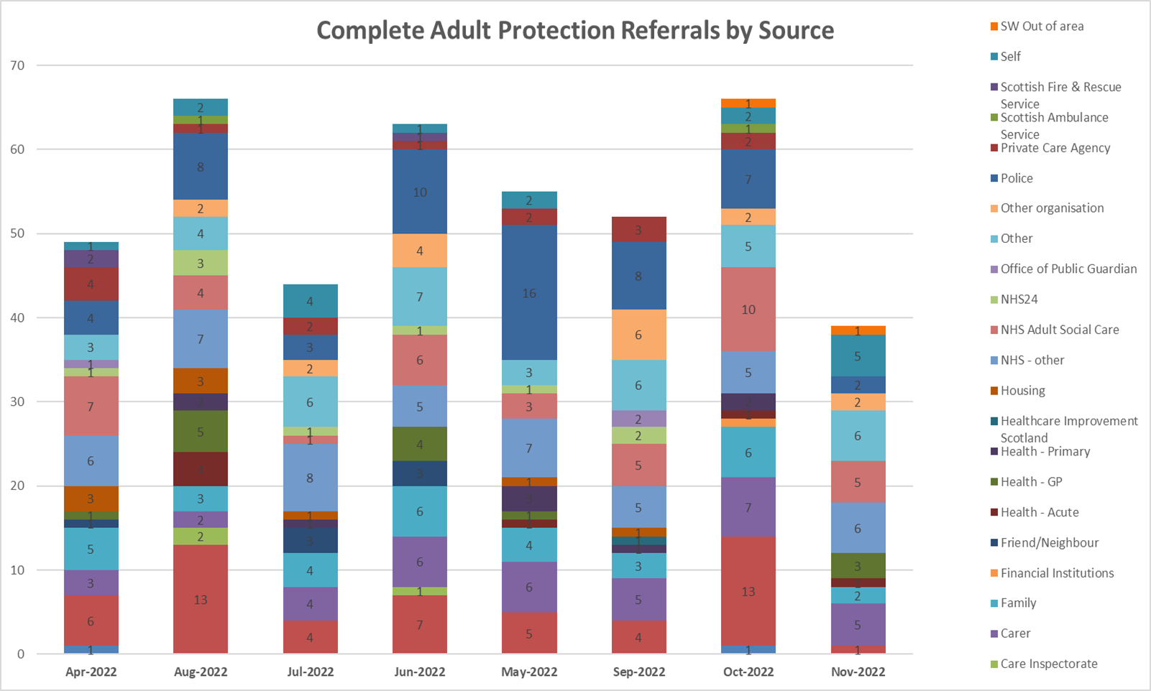
Strategic Objective 3 Outcome 9 – Care Well (Adult Social care)
Adult Protection
Adult Protection
The recent development session confirmed information on Adult Protection should be included.
Currently Adult Protection information is provided as part of an Annual Adult Protection return to PHS. A new National dataset is currently being introduced with guidelines expected in January 2023. This will require an amendment to quarterly reporting.
The number of initial referrals and inquiries received are assessed by Community Care teams as to whether or not they meet the 3 point test and should progress to an investigation. Referrals come from multiple sources as shown on the graph, previously the main source was the police however as people have become more aware of Adult Protection the numbers of referrals have increased from other sources.
The number of referrals that progress to a full investigation following the initial inquiry is approximately 30%.
Update 20/12/2022

Slide 15

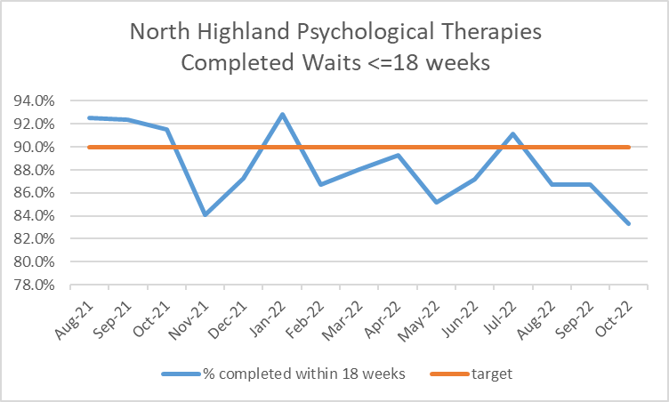
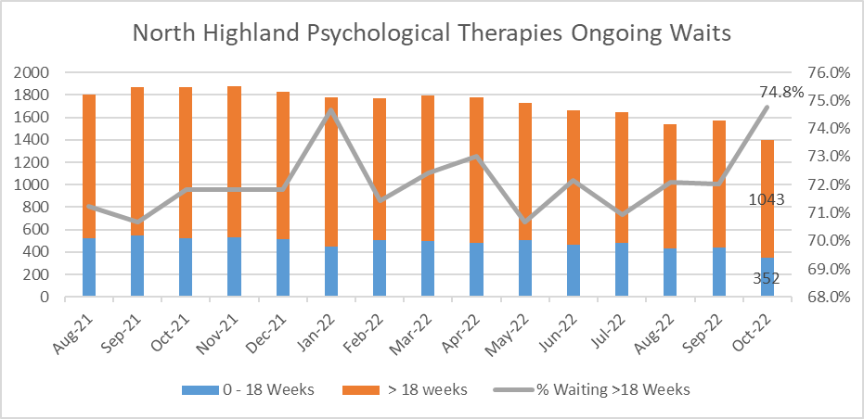
Strategic Objective 3 Outcome 10 – Live Well (Psychological Therapies)
Priority 10A,10B,10C - Ensure that both physical and mental health are on an equal footing and reduce stigma by improving access and enabling all our staff in all services to speak about mental health and wellbeing”​
Psychological Therapies North Highland 86.7% August Performance
Psychological Therapies Performance Overview​ - North Highland
The national target: 90% of people commence psychological therapy based treatment within 18 weeks of referral. ​October 2022: Current performance 83.3% ​
We have 1395 of our population waiting to access PT services in North Highland. 1043 patients are waiting >18 weeks (74.8% breached target) of which 755 have been waiting >1year. Of the 1395 waiting, 334 of those are waiting for North Highland neuropsychology services of which 322 are waiting > 1 year .​ This is a significant reduction since the August position previously reported and is a continuing improvement in reducing the waitlist.
​Psychological therapies services have had longstanding challenges with significant waiting times. There are a number of factors that have led to this including a lack of any other route for psychological interventions at an earlier stage. It is anticipated that the development of primary care mental health services will help to fill this gap in provision along with the targeted use of community resources and the development of CMHT colleagues to work with their psychological therapy colleagues. ​It has also been identified that there is a gap in the provision of Clinical Health Psychology this is currently being addressed by the Board and Director of Psychology.
​There will though always be a need for specialist services and the team are working to build a resilient model. The Director of Psychology is working closely with her team to reduce the current backlog and to build for the future. Recruitment and retention is difficult when national recruitment is taking place, however there has been some success to date and in particular we are developing our neuropsychology service which forms the majority of out current extended waits. The data provided here is already showing improvement overall with clear trajectories agreed with SG as we progress with our implementation plan. ​
Update Allyson Turnbull-Jukes 20/12/2022

Slide 16
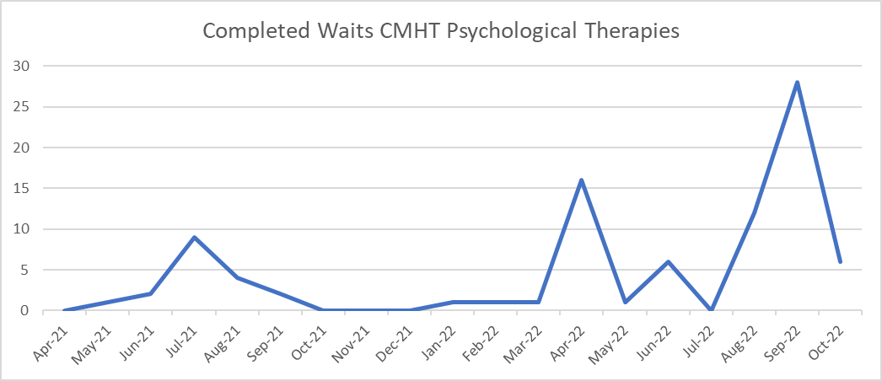
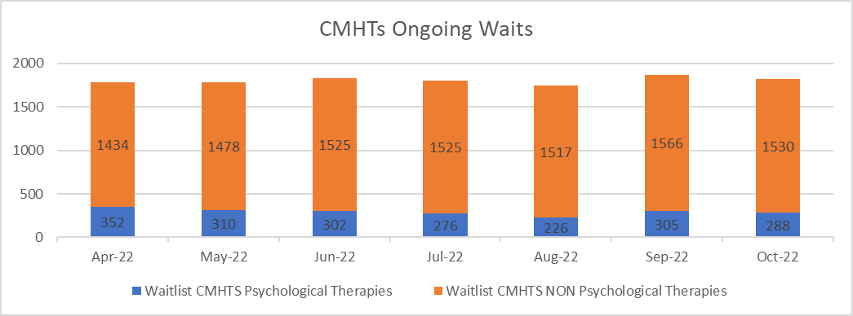
Strategic Objective 3 Outcome 10 – Live Well
Priority 10A,10B,10C - Ensure that both physical and mental health are on an equal footing and reduce stigma by improving access and enabling all our staff in all services to speak about mental health and wellbeing”​
Community Mental Health Teams
Community Mental Health Teams
The ongoing waits for CMHTs are not currently reported unless they fit the criteria for psychological therapies such as STEPPS group therapies. The delivery of these group therapies was halted during COVID and the availability of an online method was slow to progress. This has resulted in a significant backlog in this area. There is a shortage in STEPPS trainers within the UK so we are therefore exploring a range of options for increasing NHS Highland STEPPS practitioner capacity.
There are now 2 completed groups.
2 groups starting in parallel on 2nd November.
Also, in addition the PD Service are going to lead by example with an on-line STEPPS for patients across NHS Highland. Three people have been identified for the impending training.
Graph 1 – shows the number of completed waits within the CMHT PT patients waiting on group therapies.
Graph 2 – shows the ongoing waits as recorded on PMS for the last 3 months, split between PT group therapies and other patients. Validation work is required around this waitlist as has happened within PT.
Update 20/12/2022

Slide 17
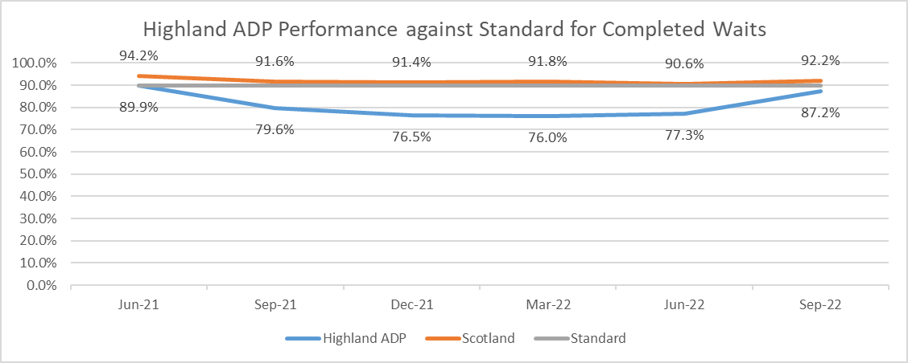
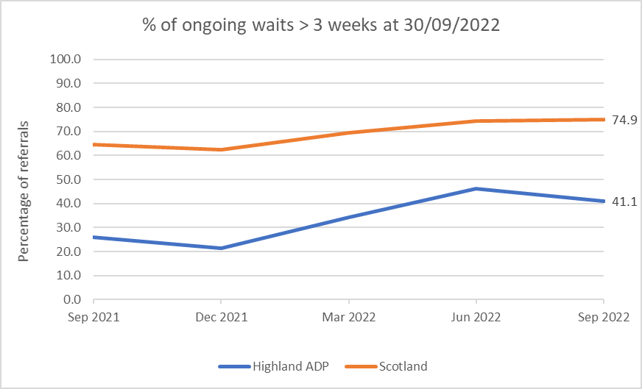
Strategic Objective 1 Outcome 3 – Our Population
Priority 3b – No patient will wait longer than 3 weeks for commencement of treatment
Highland Drug & Alcohol Recovery Services
North Highland Drug & Alcohol Services Update
PHS Publication September 2022
North Highland Drug & Alcohol Service 87.2%,
Please note the standard was achieved for people for Drug treatment in this quarter
Scotland 92.2%
Improving position
Main points completed Waits
• Of the 219 referrals to community-based specialist drug and alcohol treatment services completed in this quarter, 87% (191) involved a wait of three weeks or less.
• Of the treatment referrals completed in this quarter,
136 (62%) were for people seeking help for problematic use of alcohol,
71 (32%) for problematic use of drugs, and
12 (5%) for problematic use of both alcohol and drugs (co-dependency).
• The percentage of referrals completed within three weeks showed little variation across the treatment types: alcohol (87%, 118); drug (90%, 64) and co-dependency (75%, 9).
Main points ongoing waits
• At the end of the quarter, 90 treatment referrals had ongoing waits and from these, 37 or 41% of referrals had been waiting more than three weeks.
Data reported for Highland excludes the Crossreach Inverness Service as data for this service was incomplete at the time of publication.
Ongoing Waits North Highland Median wait 26 days for quarter 2
Scotland Median wait 9 days for quarter 2.
Priority areas include identifying areas for improvement using lean methodology and the method for improvement to release capacity in teams to further meet this standard. This work has started in some teams.
Update: Bev Fraser 20/12/2022

Slide 18
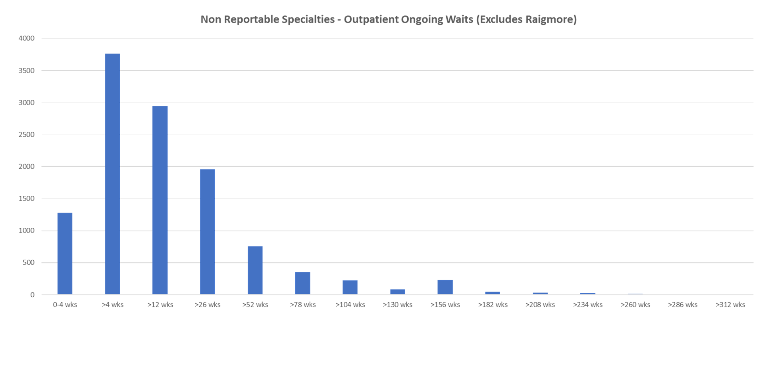
Current Overview of Non Reportable Specialties
Non Reportable Specialties – Ongoing Waits 14/12/2022
Total Waiting List – 11,705
Longest Wait > 329 weeks
This is new data to the service so requires further consideration of what it is showing. We need closer scrutiny in each of the areas in relation to data cleansing, waiting list management, waiting time targets and forward service planning.
All areas will have a level of waiting times and we need to understand what is reasonable and where the service is outside of this what are our options to reduce waiting times.
14/12/2022

Slide 19
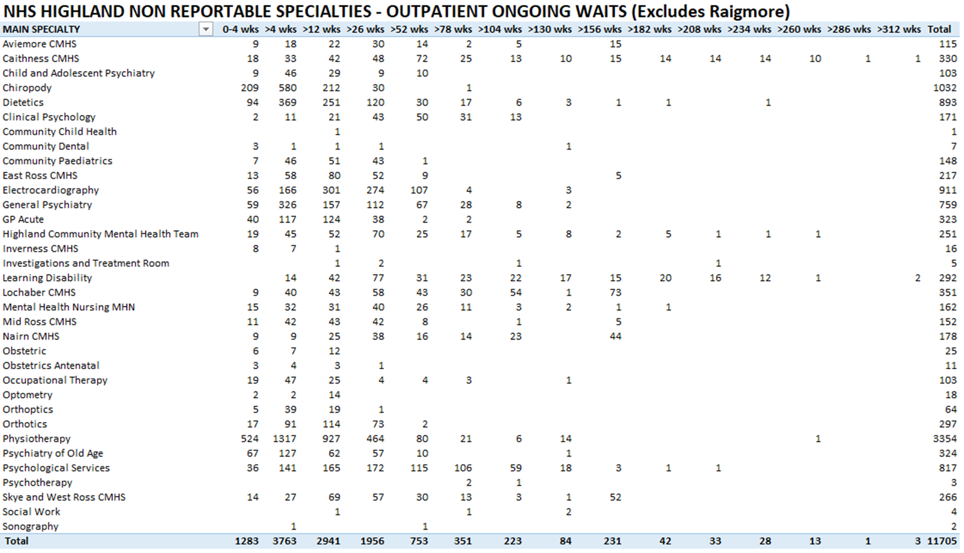
Current Overview of Community Waitlists

